Slide 1

Mobile Application Development, Fall 2021 Getting Everything Setup

Slide 2
By Hook or By Crook, Let’s Get Everything Set Up
Table of Contents
Windows Instructions
Mac Instructions
Android Emulators

Slide 3
WINDOWS INSTRUCTIONS (high level)
Install Node
Install Git
Download the boilerplate code zip file from Moodle
Open Gitbash and navigate to where you downloaded the starter code
Install the things specified in the sample project
Install expo-cli tools
Run React Native Bundler (Metro Bundler)
Open Metro Bundler
Download and Install Expo on your physical mobile device.
Run code on our physical mobile device!
Delight in the responsiveness of it all!

Slide 4
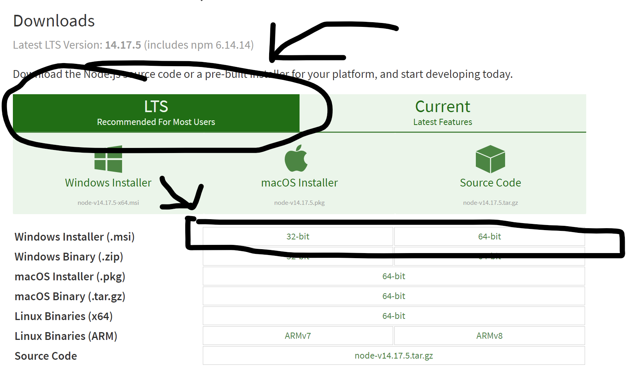
WINDOWS INSTRUCTIONS Step 1: Install Node
Go here: https://nodejs.org/en/download/
Download the LTS (Long Term Support) Version of Node on the computer you are planning on programming on.
After you download it , install it.
Why do we do this?
This will give us access to “npm” the
“Node Package Manager” – which will make it
easy to download, install, and update lots of
JavaScript libraries, which we’ll be depending on!

Slide 5
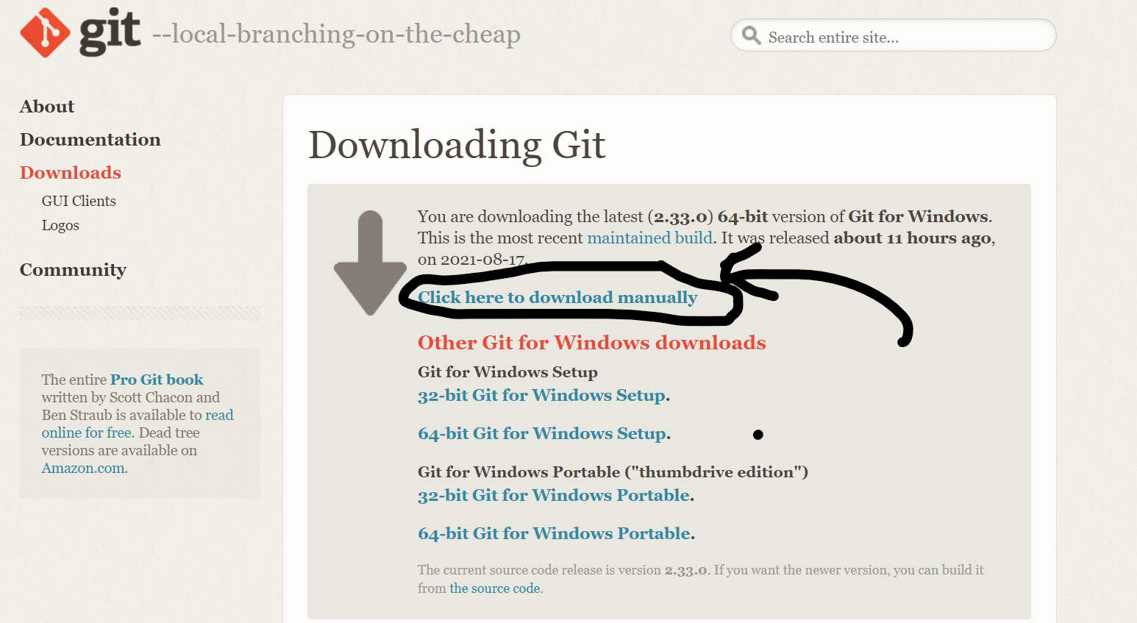
WINDOWS INSTRUCTIONS Step 2: Install Git
Note: If you went through the Java intro sequence here at UNO, there is a high chance you have Git on your machine already and don’t need to do this step. Otherwise…
Go here: https://git-scm.com/download/win and download Git onto the machine you will program on.
After you download it, install it.
If it asks you questions about GitBash, say “yes” – you DO want GitBash. It is good.
Why do we do this?
In addition to being valuable version control software,
Git Bash is going to give us a nice terminal that we can write
commands on (including ‘npm commands’ alluded to on the previous
slide to help us manage our JavaScript libraries.

Slide 6
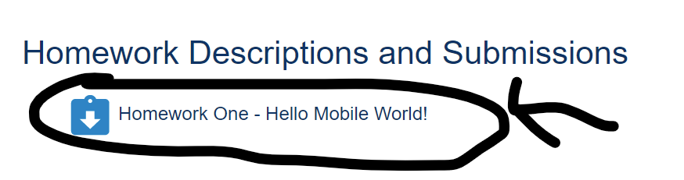
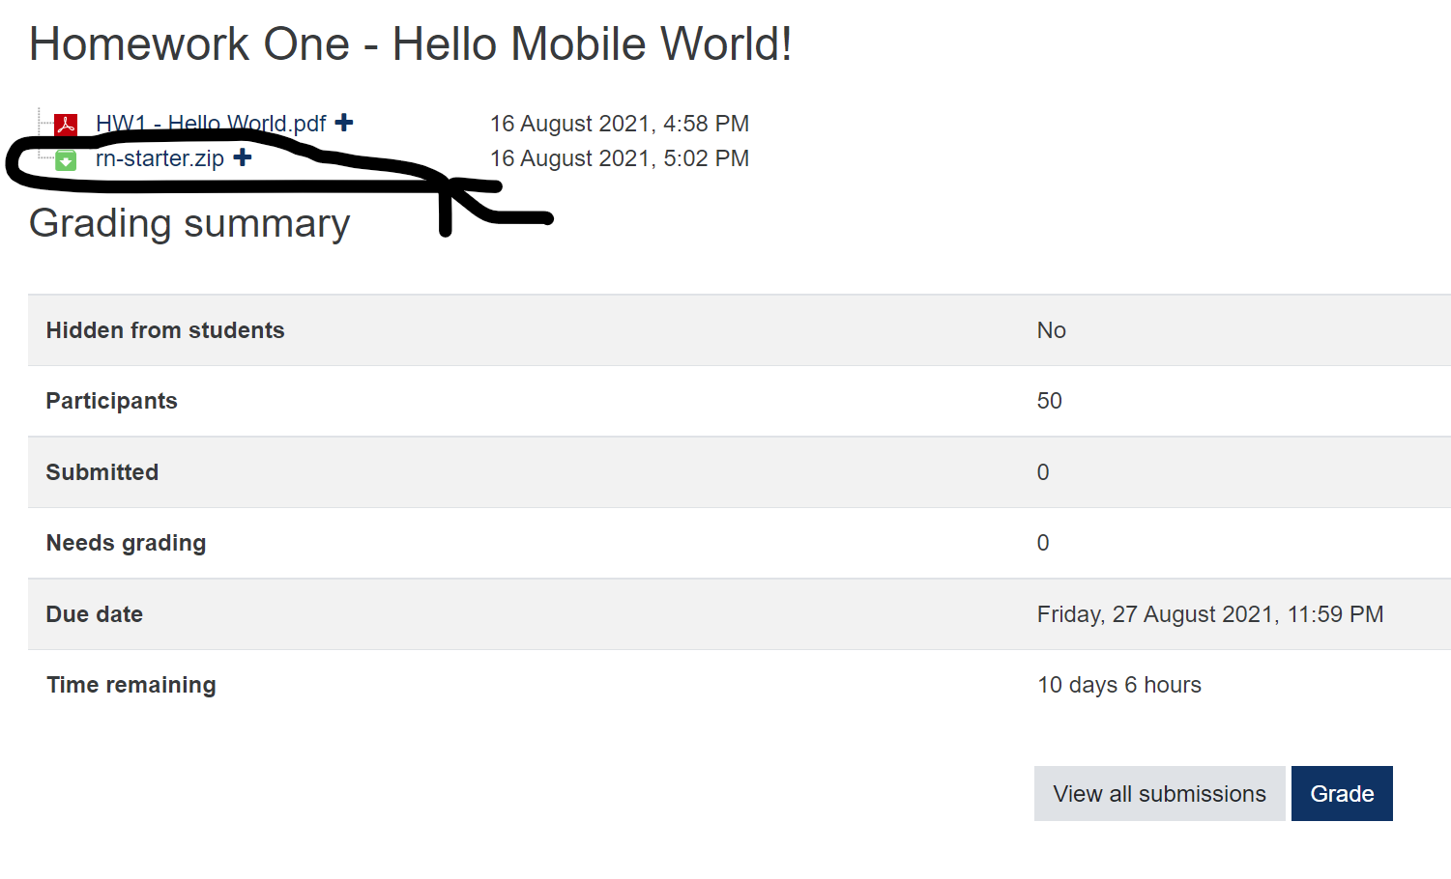
WINDOWS INSTRUCTIONS Step 3: Download Boilerplate Project
Go to the course Moodle Page, scroll down to “Homework Descriptions and Submissions”
Click on “Homework One – Hello Mobile World!”
Click on “rn-starter.zip”
Download it onto your computer at “C:\Users\YOUR_USER_NAME” (so, for me, that would be C:\Users\bmsamue1).
Extract the zip file.
Why do we do this?
Someday we’ll make projects from scratch. To get
things started more quickly, we’re using a starter project
made by react native developer Stephen Girder. We save it in our
Users directory because React Native and Expo sometimes have issues
inside of Desktop, Downloads, or Documents directories, or cloud based
directories like Google Drive or Dropbox.

Slide 7
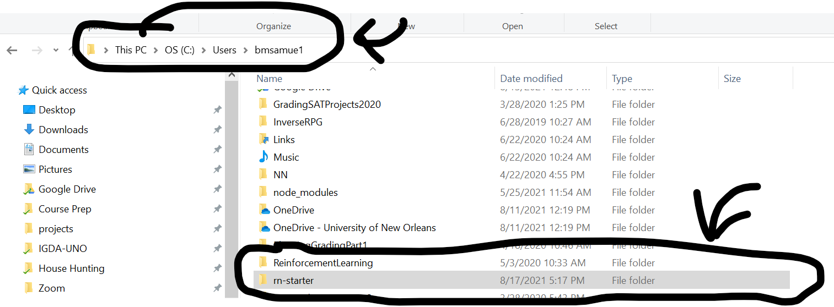
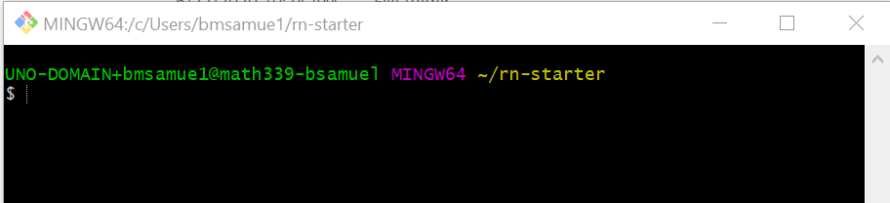
WINDOWS INSTRUCTIONS Step 4: Git Bash to the Boiler Plate Project
Open a windows file explorer, and go to the directory that you downloaded/unzipped the rn-starter project
RIGHT Click on the folder “rn-starter” – you should see an option that says “Git Bash Here” – click it.
That should open a Git Bash terminal window, in the rn-starter directory.
Helpful Terminal Commands:
ls – “list” – lists all files/folders in the current directory
cd – “change directory” move to the specified directory
. – “the current directory”
.. – “up one directory”
So, for example the command:
cd ..
Would move you “up” one directory.

Slide 8
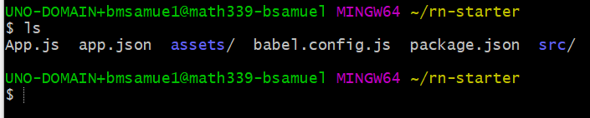
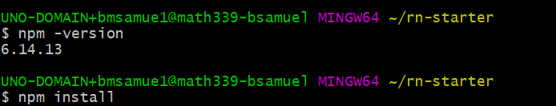
WINDOWS INSTRUCTIONS Step 5 : Install the things specified in the sample project
Type ls in the Git Bash terminal
You should see the files App.js, app.json, babel.config.js, and package.json, and the folders assets/ and src/ -- if you don’t, you are in the wrong directory.
If you are in the right directory, type the command npm install
If you are using npm v7, you may instead need to type instead npm install –legacy-peer-deps
You can verify what version of npm you are using by typing npm –version
Doing this will likely produce a lot of npm WARN messages – as long as you don’t see any ERROR messages you’re still good!
It will take a minute or two for the process to finish. Just be patient.
After doing this, you should now have a new folder in this directory, node_modules
Why do we do this?
package.json specifies many things, including which libraries the boilerplate project
depends on, and which versions of those libraries it should use. Using npm install
will ask the node package manager to download them.

Slide 9
WINDOWS INSTRUCTIONS Step 6: Install expo-cli tools
In the same GitBash terminal, type the command npm install expo-cli –global
Once again, this will likely produce a lot of npm WARN messages – that’s OK! Error messages are *not* OK.
Why do we do this?
cli in this context stands for “Command Line Interface”
“Expo” is the app that we’ll be installing on our phones that will let us test our code on our actual device.
This command sets our computer up with everything it needs to be able to be able to get our app to our physical device.

Slide 10
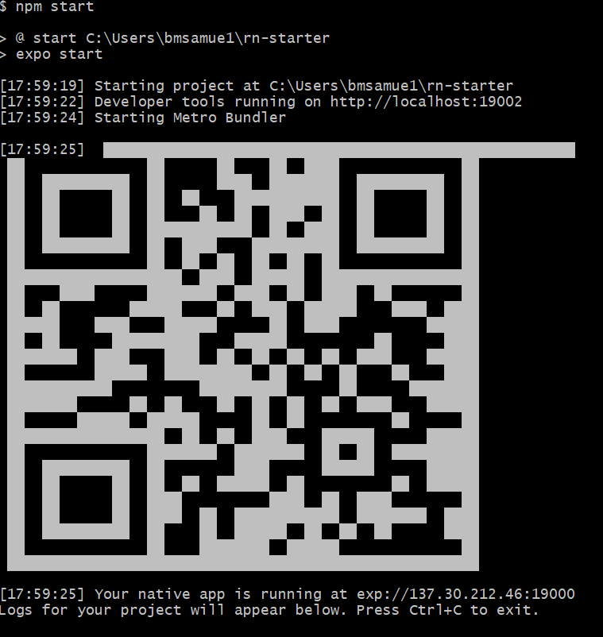
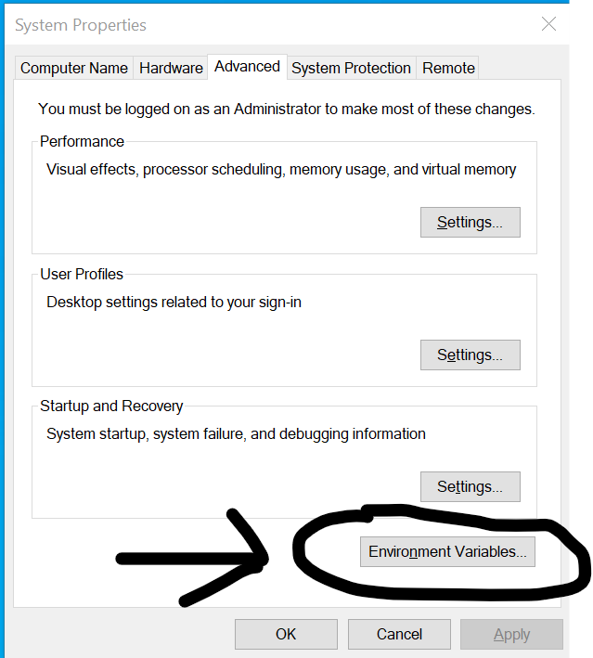
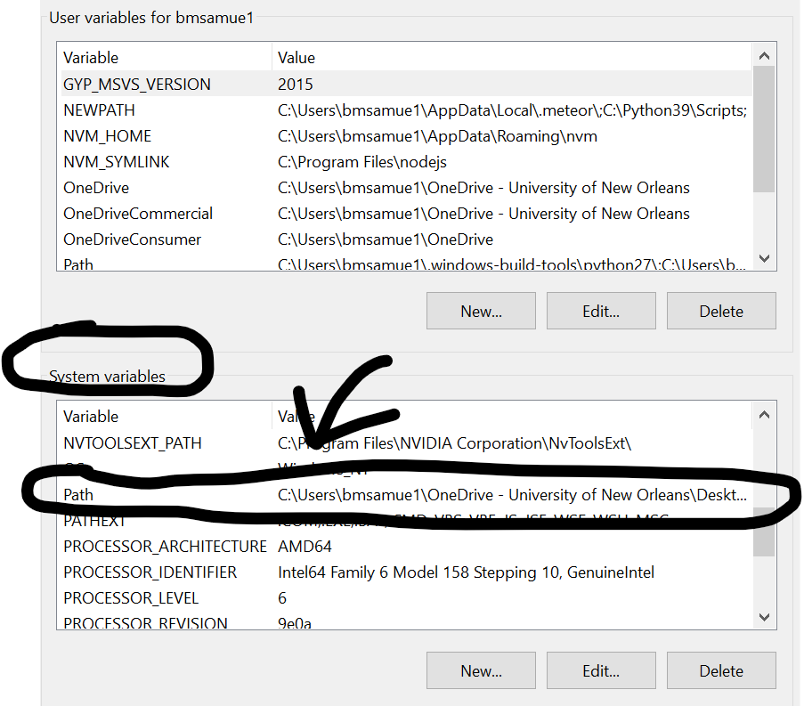
WINDOWS INSTRUCTIONS Step 7: Run React Native Bundler
In the same GitBash terminal, type the command npm start
This should go pretty quickly, and produce what is essentially a QR code.
You should also sese something that says “Developer tools running on http://localhost:19002
If you get a message that expo-cli tools are not installed, you need to make sure that NPM has been added to your environment variables.
To do that: open Windows search bar, type “environment”, select “Edit the System Environment Variables”
Click “Environment Variables”
Double click “Path” under “System Variables”
Click the “New” button and add the following path: %USERPROFILE%\AppData\Roaming\npm
Why do we do this?
Again, in “package.json”, the command “start” was specified to mean “start up expo”, which
here means starting the “React Native Bundler” (AKA the Metro Bundler). The Metro Bundler is an HTTP Server that compiles the code
of our app using the transpiler Babel and will serve it to the Expo app. If you don’t understand that, don’t worry!
In short: The localhost port (http://localhost:19002) is how we’ll get our code onto our phone.

Slide 11
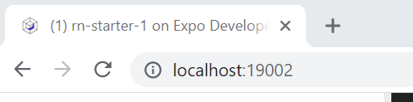
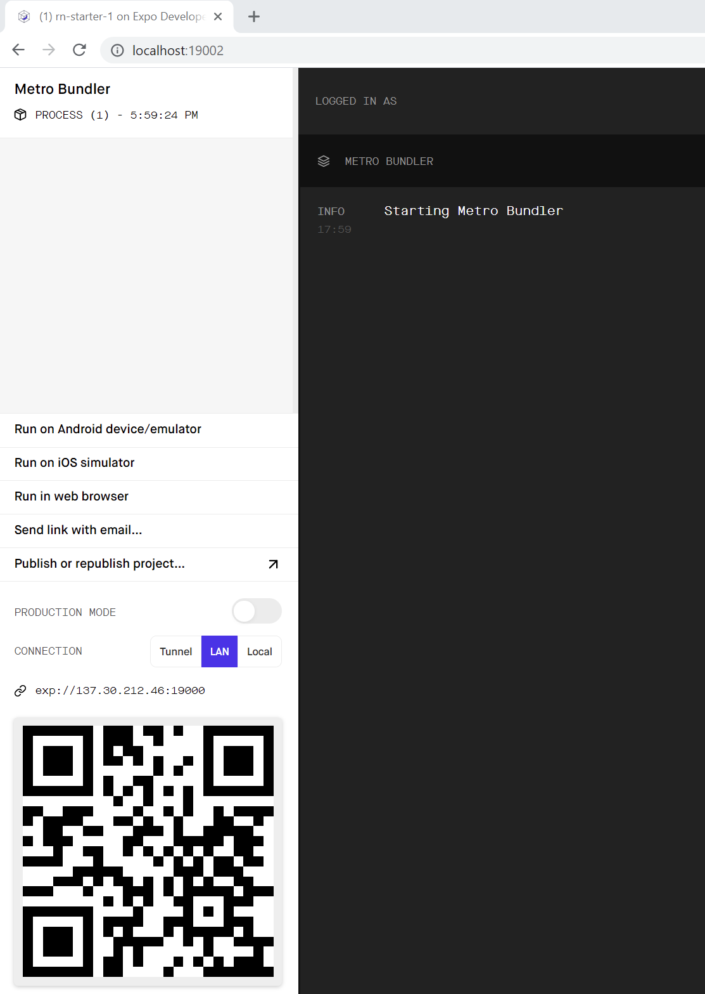
WINDOWS INSTRUCTIONS Step 8: Open Metro Bundler
Open a Web Browser (e.g., Chrome)
Navigate to: localhost:19002
Why do we do this?
The “Expo” app will use this to get our code onto our
physical device.

Slide 12
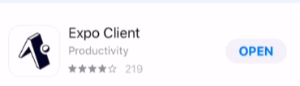
WINDOWS INSTRUCTIONS Step 9: Download and Install Expo on your physical mobile device.
On your physical mobile device, go to the Apple App Store, or the Google Play Store.
Do a search for “Expo”
You should see something that says “Expo” or “Expo Client” or “Expo Go”
Install it.
Why do we do this?
Expo is going to “read in” that QR code we generated a second ago to get our code to run on our device.

Slide 13
WINDOWS INSTRUCTIONS Step 10: Run code on our physical mobile device.
Very Important: Make sure your phone is on the same wifi network as your device running the metro bundler
Open your phone’s camera application (or open the Expo app you just downloaded and select “Scan QR Code”)
Hover your phone’s camera over the QR code at localhost:19002
If prompted, click the link that pops up.
Watch your phone download and update and then display an awesome app!
Why do we do this?
This is the final step, and how we can test our code on our own physical phone! What you are seeing is the app defined the by boiler plate project! It should basically just be an empty screen that says “HomeScreen” on it.

Slide 14
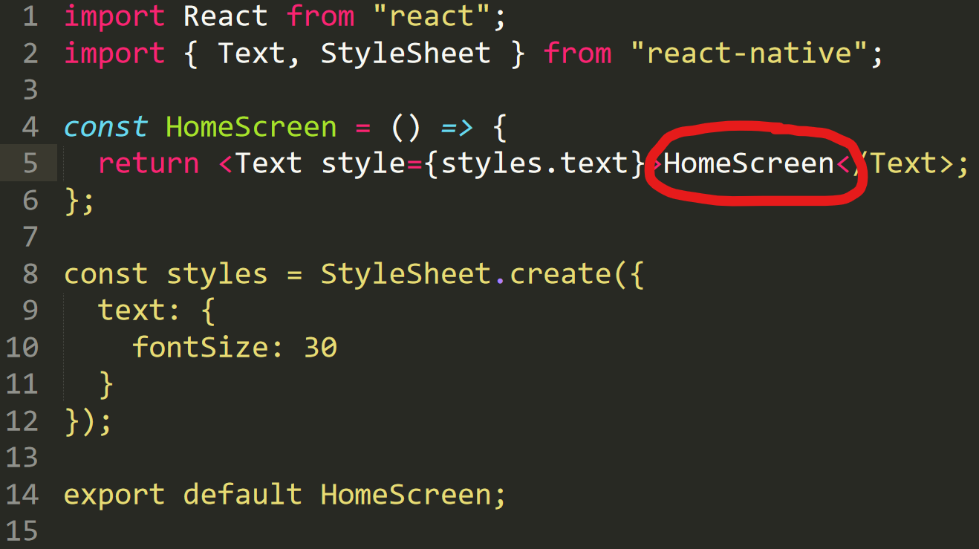
WINDOWS INSTRUCTIONS Step 11: Delight in the Responsiveness
On your file system, go to rn-starter/src/screens/ and open up HomeScreen.js with your editor of choice (e.g., Sublime, Visual Studio Code, etc.)
On line 5, change the text of HomeScreen to say something else. Anything you like!
Save the file
Look at your physical phone! It should update to display the new text!
Why do we do this?
We now have the ability to officially test our
applications on a real life phone! And for us to be
able to make changes to this applications and those changes
to be immediately reflected! Congratulations!!!!!!

Slide 15
WINDOWS INSTRUCTIONS AFTER EVERYTHING IS SET UP FOREVER…
The above was long and arduous, but thankfully is more or less a one-time thing. Moving forward, if you wanted to run this project again, you would just do the following:
Navigate to the project directory in GitBash (making sure you are in the folder that has “package.json”)
Type npm start
Open localhost:19002 in a web browser
Scan the QR code from the webpage using your phone’s camera/the Expo App.
See? Hardly a pain at all!

Slide 16
MAC INSTRUCTIONS (high level)
Install Node
Download the boilerplate code zip file from Moodle
Open your Terminal and navigate to where you downloaded the starter code
Install the things specified in the sample project
Attempt to start the React Native Bundler (Metro Bundler)
Things to try if Step #5 doesn’t go well.
Open Metro Bundler
Download and install Expo on your physical mobile device.
Run code on our physical mobile device!
Delight in the responsiveness of it all!

Slide 17
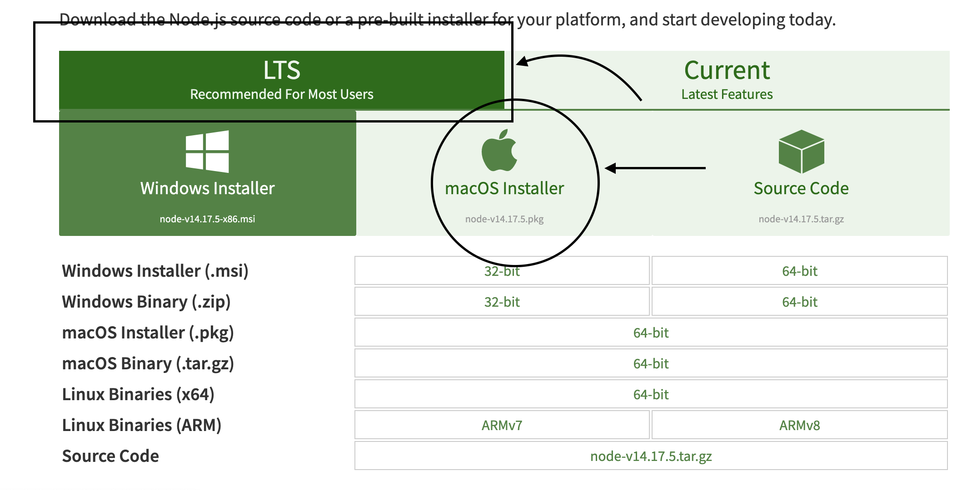
MAC INSTRUCTIONS Step 1: Install Node
Go here: https://nodejs.org/en/download/
Download the LTS (Long Term Support) Version of Node on the computer you are planning on programming on.
After you download it , install it.
Why do we do this?
This will give us access to “npm” the
“Node Package Manager” – which will make it
easy to download, install, and update lots of
JavaScript libraries, which we’ll be depending on!

Slide 18
MAC INSTRUCTIONS Step 2: Download Boilerplate Project
Go to the course Moodle Page, scroll down to “Homework Descriptions and Submissions”
Click on “Homework One – Hello Mobile World!”
Click on “rn-starter.zip”
Download it onto your computer at “Users/YOUR_USER_NAME” (so, for me, that would be /Users/ben
Extract the zip file.
Why do we do this?
Someday we’ll make projects from scratch. To get
things started more quickly, we’re using a starter project
made by react native developer Stephen Girder. We save it in our
Users directory because React Native and Expo sometimes have issues
inside of Desktop, Downloads, or Documents directories, or cloud based
directories like Google Drive or Dropbox.

Slide 19
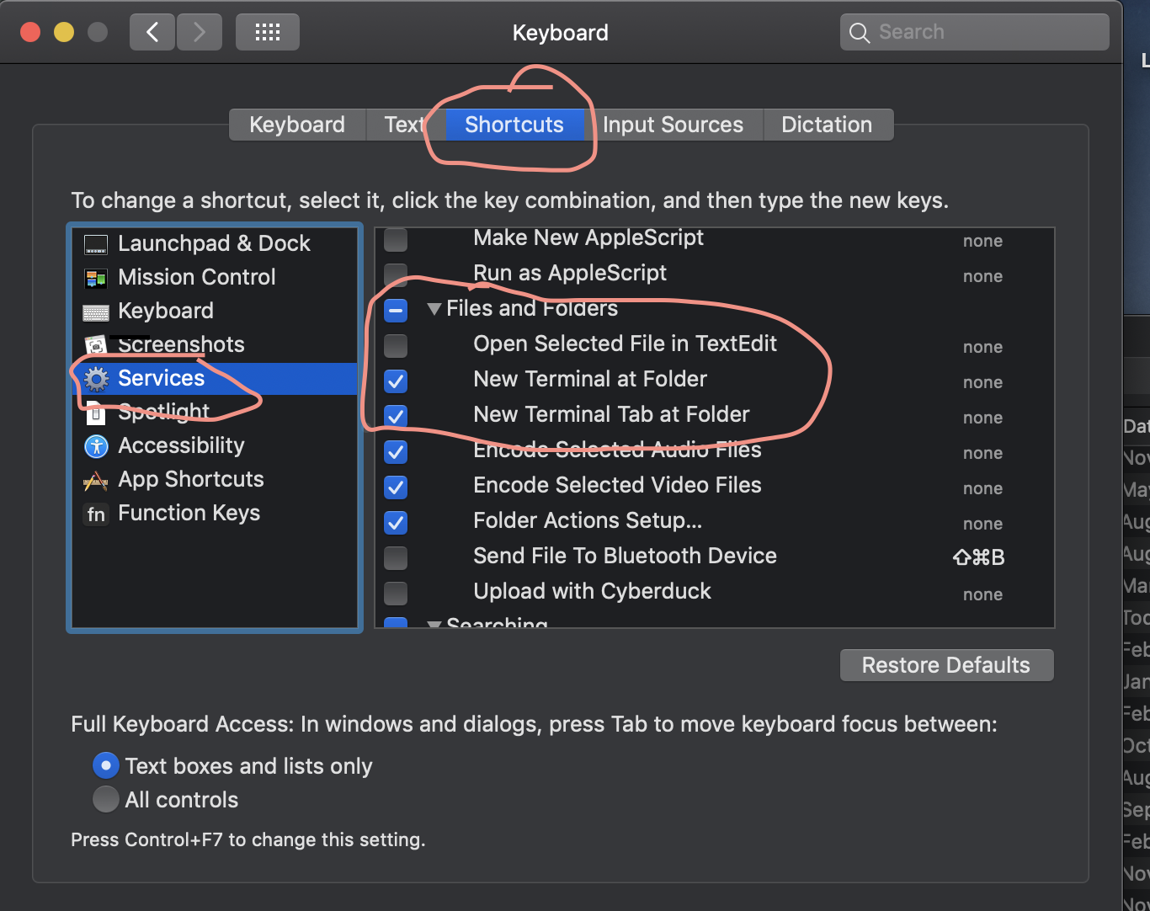
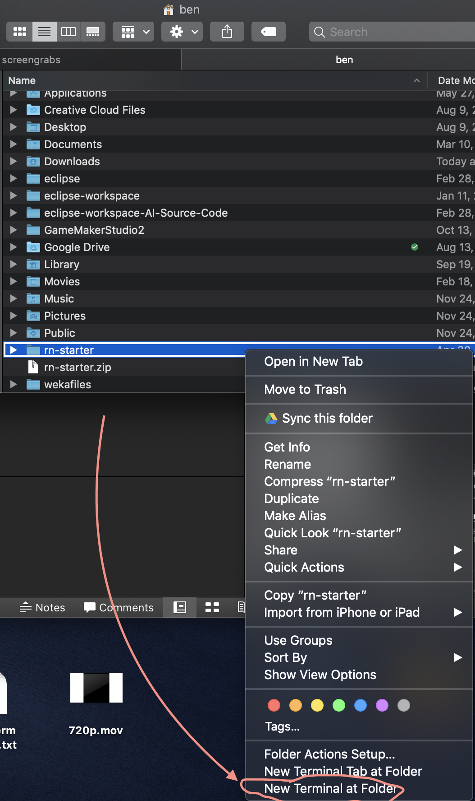
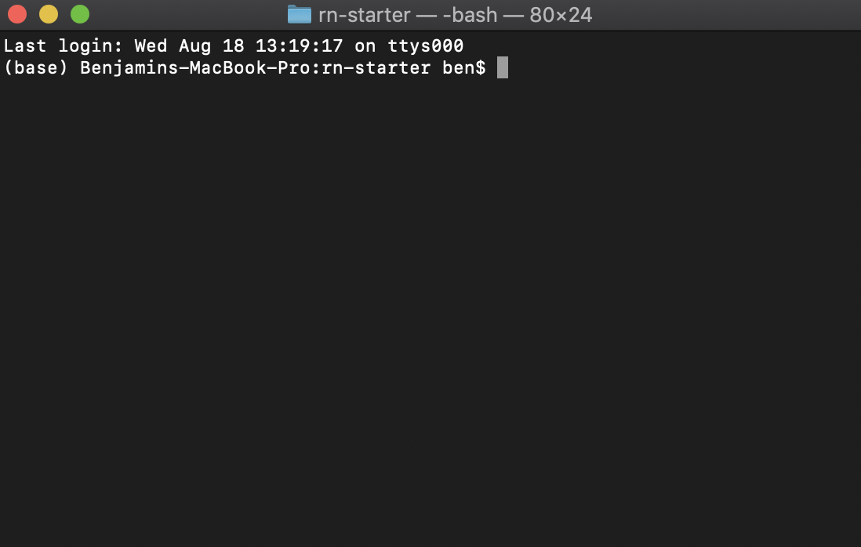
MAC INSTRUCTIONS Step 3: Open Terminal at Boiler Plate Project
Helpful Terminal Commands:
ls – “list” – lists all files/folders in the current directory
cd – “change directory” move to the specified directory
. – “the current directory”
.. – “up one directory”
So, for example the command:
cd ..
Would move you “up” one directory.
Open System Preferences
Click on Keyboard
Click on the “Shortcuts” Tab along the top
Click on “Services” along the left
Scroll down to “Files and Folders”
Make sure “New Terminal at Folder” and “New Terminal Tab at Folder” are checked
Open Finder
Navigate to your User Directory
Right click on the unzipped rn-starter folder
Click ”New Terminal at Folder” (probably close to the bottom.

Slide 20
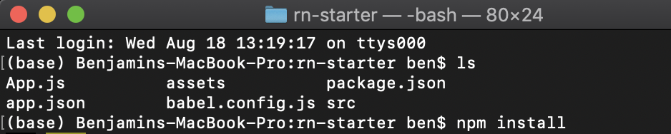
MAC INSTRUCTIONS Step 4 : Install the things specified in the sample project
Type ls in the Terminal
You should see the files App.js, app.json, babel.config.js, and package.json, and the folders assets/ and src/ -- if you don’t, you are in the wrong directory.
If you are in the right directory, type the command npm install
If you are using npm v7, you may instead need to type instead npm install –legacy-peer-deps
You can verify what version of npm you are using by typing npm –version
Doing this will likely produce a lot of npm WARN messages – as long as you don’t see any ERROR messages you’re still good!
It will take a minute or two for the process to finish. Just be patient.
After doing this, you should now have a new folder in this directory, node_modules
Why do we do this?
package.json specifies many things, including which libraries the boilerplate project
depends on, and which versions of those libraries it should use. Using npm install
will ask the node package manager to download them.

Slide 21
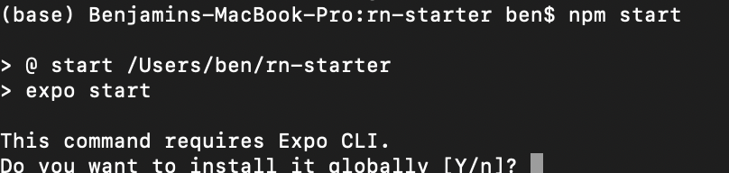
MAC INSTRUCTIONS Step 5 : Attempt to Start the React Native Bundler
Cross your fingers, and type npm start in the same terminal window.
You may be prompted to install the Expo CLI tools globally. If so, type Y for yes and hit enter again. Keep crossing your fingers.
If your experience is like mine, you will get a lot of permission errors. Bummer. Move on to Step 6 for some things to try to resolve them.
Why do we do this?
Even though you might not have been successful in this step, cli in this context stands for “Command Line Interface”
“Expo” is the app that we’ll be installing on our phones that will let us test our code on our actual device.
This command sets our computer up with everything it needs to be able to be able to get our app to our physical device.

Slide 22
MAC INSTRUCTIONS Step 6 Part 1: Things to Try if Step 5 Went Badly
You may be tempted to use sudo to resolve the permission issues, as often that is the catch-all solution. However, it is *not* recommended you do that here, as it might end up causing even more permission issues in the long run.
Instead, we are going to make a new global install path, and teach npm about it.
First, to make the global install path, type the following into your terminal: mkdir ~/.npm-global
Then to tell npm about it, type the following into your terminal: npm config set prefix ‘~/.npm-global’

Slide 23
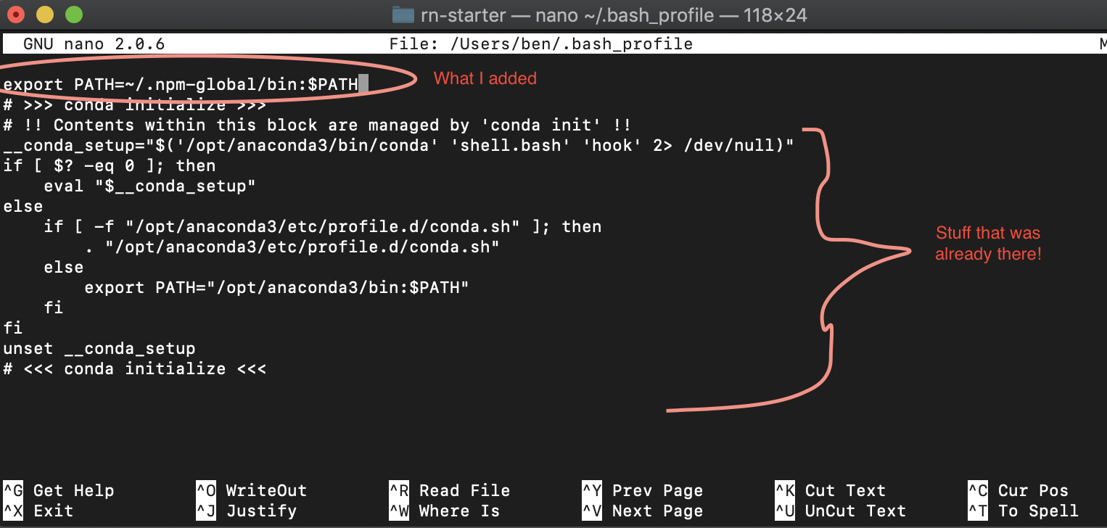
MAC INSTRUCTIONS Step 6 Part 2: Things to Try if Step 5 Went Badly
Next, we need to do know what shell we are using. It is likely going to be either bash or zsh (for me it is bash). In order to figure that out, type this into your terminal: ps –o comm= $$ it will print out your shell on a new line.
If the previous step said ‘zsh’ you’ll create a zshrc profile by typing nano ~/.zshrc. Instead, if the previous step said ‘bash’, you will create a bash_profile by typing nano ~/.bash_profile
Regardless of what you typed above, Nano is a simple text editor, which should open automatically after running it above. Inside of this text editor, type the following: export PATH=~/.npm-global/bin:$PATH
Exit out of nano by typing CTL + X to exit. You’ll be prompted to save – type y and then hit enter to save your changes.

Slide 24
MAC INSTRUCTIONS Step 6 Part 3: Things to Try if Step 5 Went Badly
Incredibly enough, I ran into permission issues again when trying to save my bash_profile.
Here you should be able to use sudo safely. I just changed myself to the owner of bash_profile with the command: sudo chown YOURUSERNAME ~/.bash_profile
So, because my username is ben, I typed sudo chown ben ~/.bash_profile
If it didn’t let you save due to permission errors in the previous steps, then make sure you go back into Nano with
nano ~/.bash_profile
and add the line
export PATH=~/.npm-global/bin:$PATH
Once again, hit CTL + X to exit Nano, hit ‘y’ when prompted to save, and then just hit enter to overwrite the .bash_profile

Slide 25
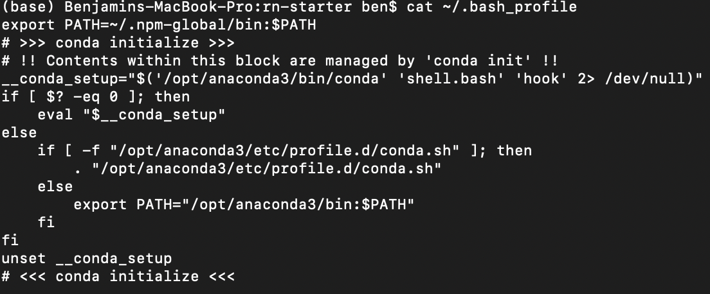
MAC INSTRUCTIONS Step 6 Part 4: Things to Try if Step 5 Went Badly
Verify that you actually edited the file with the following command:
cat ~/.bash_profile
If all is well, it should print out the contents of your bash_profile – including the new line you just added to it.
Exit your terminal completely (i.e., close it by pushing the red x).
Reopen it as you did before (right click on the rn-starter folder, select “new terminal at folder” – verify you are in the right place by typing ‘ls’

Slide 26
MAC INSTRUCTIONS Step 6 Part 5: Things to Try if Step 5 Went Badly
Install the global expo-cli tools to the new location by typing the following:
npm install expo-cli --global
Into your terminal. This will likely take a little bit, and you will probably see a lot of Warnings. But if all went according to plan, there should be no more errors!

Slide 27
MAC INSTRUCTIONS Step 6 Epilogue: Things to Try if Step 5 Went Badly
Why do we do this?
I don’t know. Why do we do this to ourselves? It’s a great question.
Seriously though, I tried to explain the “why” along with the “what”, but it boils down to our computers trying to protect us from ourselves, and us trying to convince the computers that we are good and that we know what we are doing.
The bash_profile is a way to configure your user environment with persistence (as opposed to only within a single terminal window).
Adding export PATH=~/.npm-global/bin:$PATH to the bash_profile basically added ~/.npm-global/bin to our path (we pre-pended it to our path, technically speaking). The path is a list of colon separated paths,.
By adding it to the path, now our computer knows a new place to look for things we want to run.
When we typed npm config set prefix ‘~.npm-global’ that was us telling us where npm should install global things (e.g., the npm install expo-cli –global command) – it now installs it in this new folder (that we have permissions for), and by adding the bin to the path, it will enable our computer to just run it without specifying the whole absolute path to it each time.

Slide 28
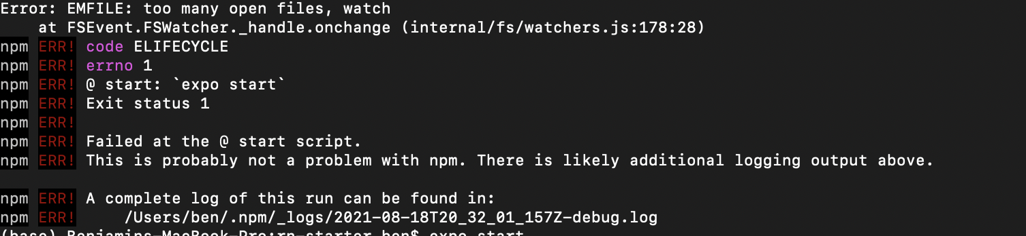
MAC INSTRUCTIONS Step 7 Part 1: Open Metro Bundler
This is something that in theory should be easy, but I ended up running into troubles to as well.
From the same terminal window, type npm start
If all went according to plan, you should see a big QR code appear.
However, if you are like me, then you might see a bunch of errors regarding there being too many files open.

Slide 29
MAC INSTRUCTIONS Step 7 Part 2: Open Metro Bundler
React Native will use a tool called watchman if it is available, which can help resolve this issue.
To install watchman, you can first setup Homebrew, another package manager. You can read about it here: https://brew.sh/
To set up Homebrew, first type the following command into your terminal (all on one line): /bin/bash -c "$(curl -fsSL https://raw.githubusercontent.com/Homebrew/install/HEAD/install.sh)”
This will probably take a few minutes! Just be patient!

Slide 30
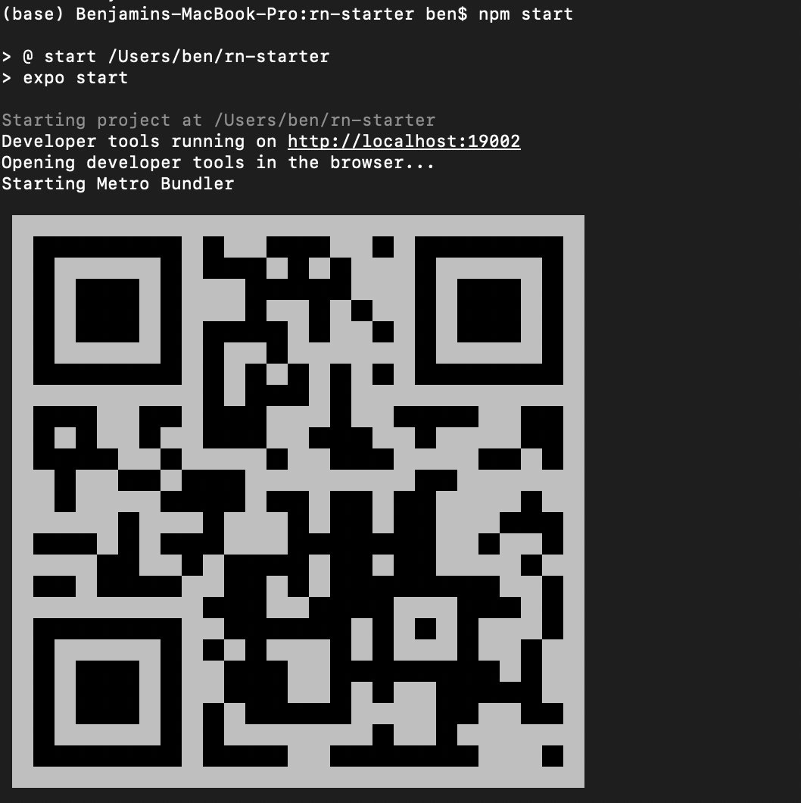
MAC INSTRUCTIONS Step 7 Part 3: Open Metro Bundler
Once you have Homebrew setup, you can install watchman with the following command on the terminal: brew install watchman
If you receive a message about the brew command not being recognized, close your terminal window and re-open it in the same location, and try again.
Again, this could potentially take a few minutes. Please be patient.
Once it is finished, try running the metro bundler again with the command npm start
If successful, you should receive a QR code like the following.
For me, it also automatically opened up a webpage.
If your webpage didn’t open, open a browser (e.g., chrome).
And enter this address: http://localhost:19002/

Slide 31
MAC INSTRUCTIONS Step 8: Download and Install Expo on your physical mobile device.
On your physical mobile device, go to the Apple App Store, or the Google Play Store.
Do a search for “Expo”
You should see something that says “Expo” or “Expo Client” or “Expo Go”
Install it.
Why do we do this?
Expo is going to “read in” that QR code we generated a second ago to get our code to run on our device.

Slide 32
MAC INSTRUCTIONS Step 9: Run code on our physical mobile device.
Very Important: Make sure your phone is on the same wifi network as your device running the metro bundler
Open your phone’s camera application (or open the Expo app you just downloaded and select “Scan QR Code”)
Hover your phone’s camera over the QR code at localhost:19002
If prompted, click the link that pops up.
Watch your phone download and update and then display an awesome app!
Why do we do this?
This is the final step, and how we can test our code on our own physical phone! What you are seeing is the app defined the by boiler plate project! It should basically just be an empty screen that says “HomeScreen” on it.

Slide 33
MAC INSTRUCTIONS Step 10: Delight in the Responsiveness
On your file system, go to rn-starter/src/screens/ and open up HomeScreen.js with your editor of choice (e.g., Sublime, Visual Studio Code, etc.)
On line 5, change the text of HomeScreen to say something else. Anything you like!
Save the file
Look at your physical phone! It should update to display the new text!
Why do we do this?
We now have the ability to officially test our
applications on a real life phone! And for us to be
able to make changes to this applications and those changes
to be immediately reflected! Congratulations!!!!!!

Slide 34
MAC INSTRUCTIONS AFTER EVERYTHING IS SET UP FOREVER…
The above was long and arduous, but thankfully is more or less a one-time thing. Moving forward, if you wanted to run this project again, you would just do the following:
Navigate to the project directory using Terminal (making sure you are in the folder that has “package.json”)
Type npm start
Open localhost:19002 in a web browser
Scan the QR code from the webpage using your phone’s camera/the Expo App.
See? Hardly a pain at all!

Slide 35
ANDROID EMULATOR HIGH LEVEL STEPS (note: you will still need to do the previous steps for the operating system of your choice)
Download and install Android Studio.
Create an Android Virtual Device (AVD)
Launch your code on the AVD!
Again: This guide assumes that you have already gone through all of the previous steps for either Mac or Windows. These instructions are for those of you without physical phones to test on.

Slide 36
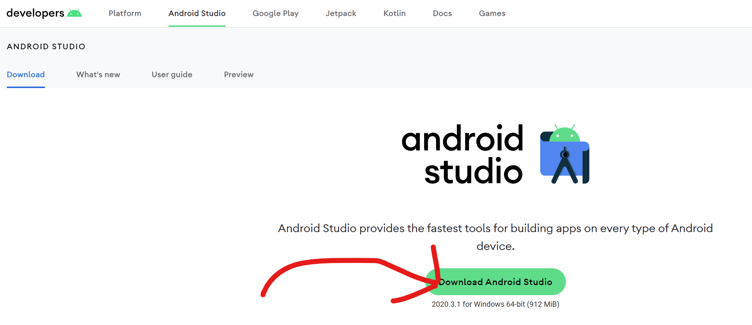
ANDROID EMULATOR STEP 1: DOWNLOAD AND INSTALL ANDROID STUDIO
Android Studio can be found here: https://developer.android.com/studio
Click on the Download Android Studio button, and install it as you would any other app.
Android Studio is *very large.* It will take *a while* to get this up and running on your machines.
Why do we do this?
Android Studio is the go-to IDE for Android development. It makes it very easy to create emulators of Android devices, which we can use to test our mobile apps on if we don’t have a physical phone of our own.
Also it’s what we used in previous incarnations of this class when we only did Android programming! That’s more of just a fun fact than anything else, though.

Slide 37
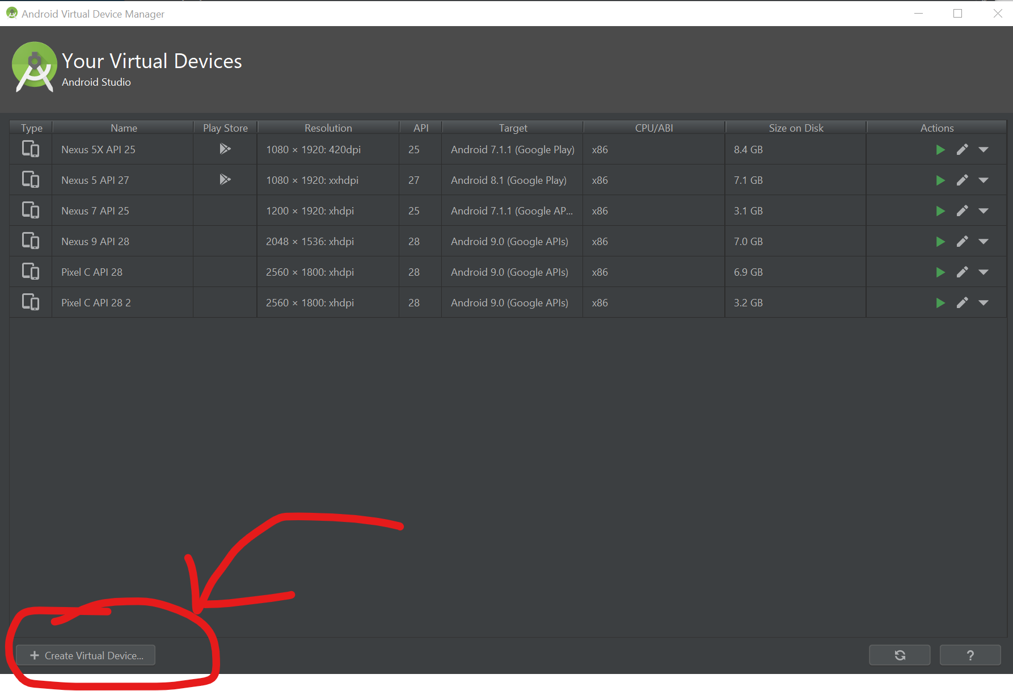
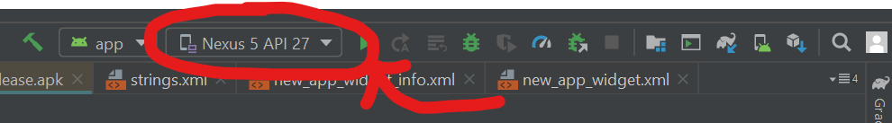
ANDROID EMULATOR STEP 2 Part 1: Create an Android Virtual Device (AVD)
First, open the AVD manager. I already have a bunch of AVD’s made, but if you just installed Android Studio you probably won’t, so your screen might look different from mine. It should be in the upper-right-ish corner of Android Studio, maybe as a drop down box with the option “Open AVD Manager.”
Once the AVD Manager is open, click the “Create Virtual Device” button.

Slide 38
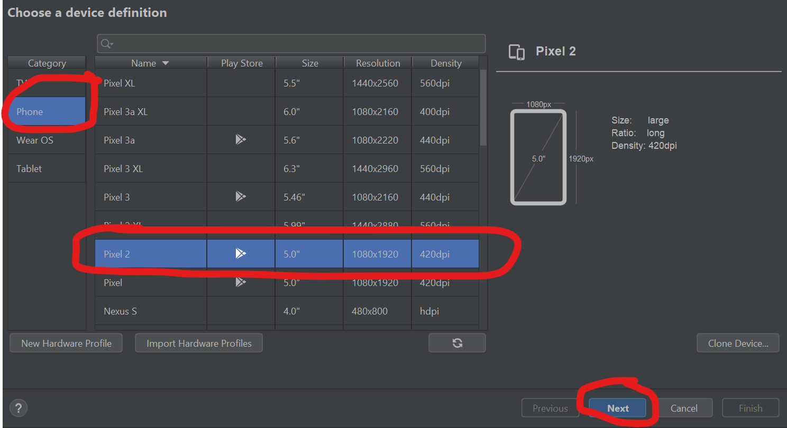
ANDROID EMULATOR STEP 2 Part 2: Create an Android Virtual Device (AVD)
You can now design the specifications of any device you want! Let’s create a Pixel 2 together!
Make sure “Phone” is the Category on the left, then select Pixel 2 in the list. Click Next.

Slide 39
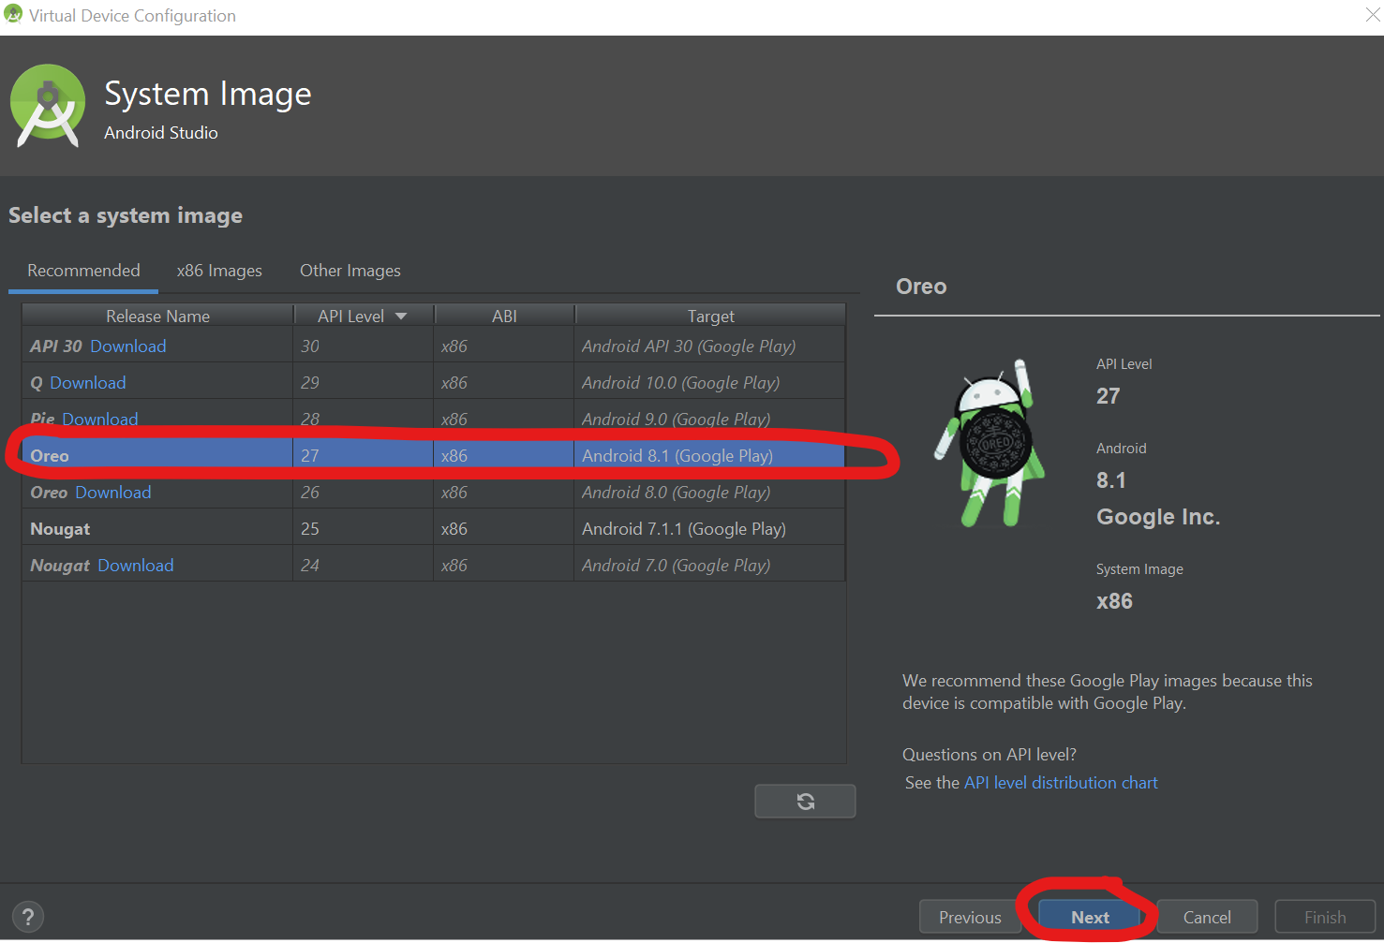
ANDROID EMULATOR STEP 2 Part 3: Create an Android Virtual Device (AVD)
Then select what API version of Android you want to use. Let’s say Oreo for now (if you want something else, it *shouldn’t* really matter.
You may have to download which version you choose before you may select it.
After you have selected your version, click Next.

Slide 40
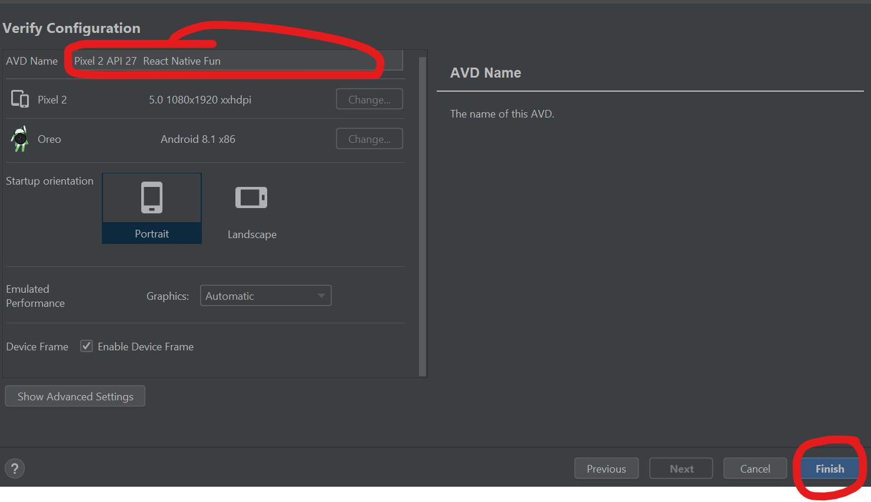
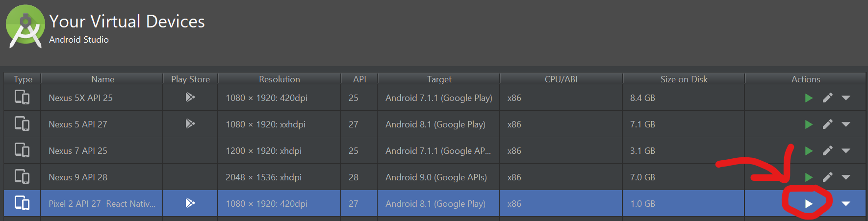
ANDROID EMULATOR STEP 2 Part 4: Create an Android Virtual Device (AVD)
Give your AVD a name, if you wish!
Then click “Finish”
(FYI, “Show Advanced Settings” has some neat things too, but you shouldn’t have to mess with them for now).
After that, it should be on the AVD list! Launch it by pushing the green “play” button.

Slide 41
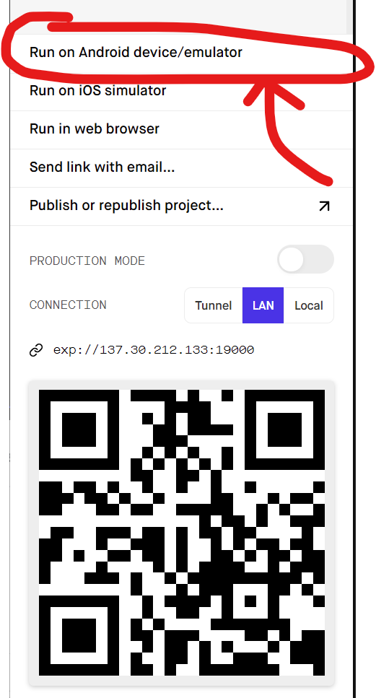
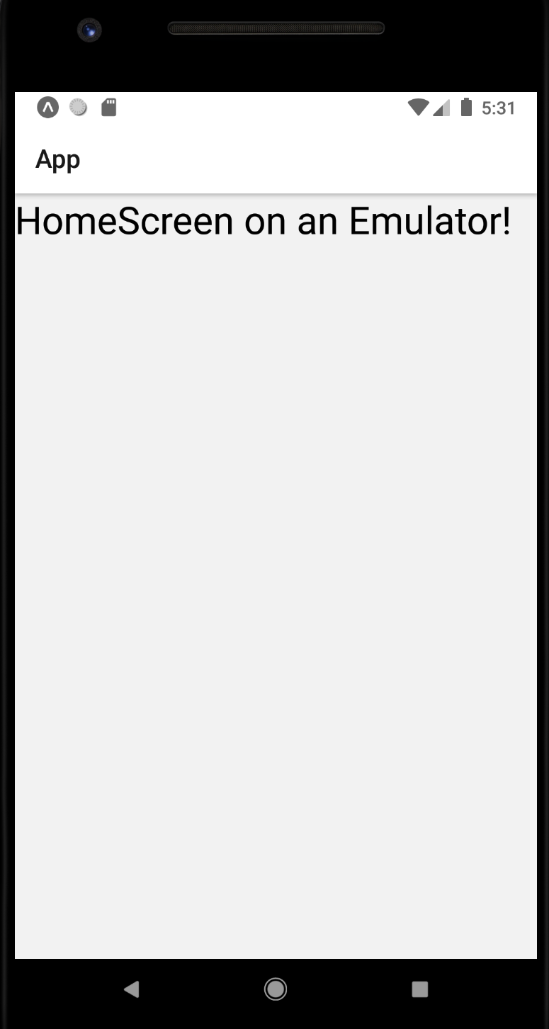
ANDROID EMULATOR STEP 3: Launch your code on the AVD!
After launching your AVD, go check out the http://localhost:19002/ page again (if you don’t have it running, boot it up by typing “npm start” in the directory your project’s package.json file is in.
You should see an option “Run on Android device/emulator. Click it!
You should see a message saying “attempting to open simulator”
You’ll have to wait for about a minute or so. Just be patient.
Soon, you should see your app show up on your emulator!
If you change the text of HomeScreen.js, you should see it reflected.

